Slide 1

Team Optimus
Pawan K Patidar
Madhu Goyal
Sanjeev Jaiswal
Manan Gandhi
Raja Chadokar

Slide 2
Triggering Habit Formation: Simplifying Client Activation

Slide 3
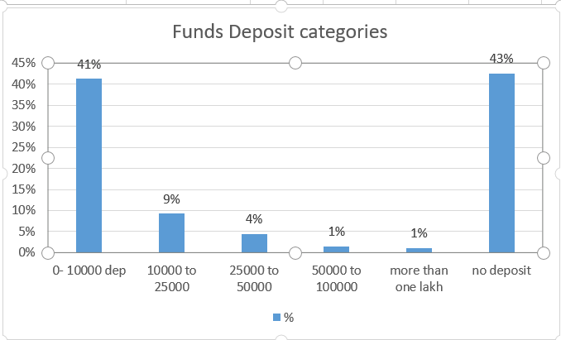
Data Analysis on Client’s lifecycle in Swastika based on first deposit

Slide 4
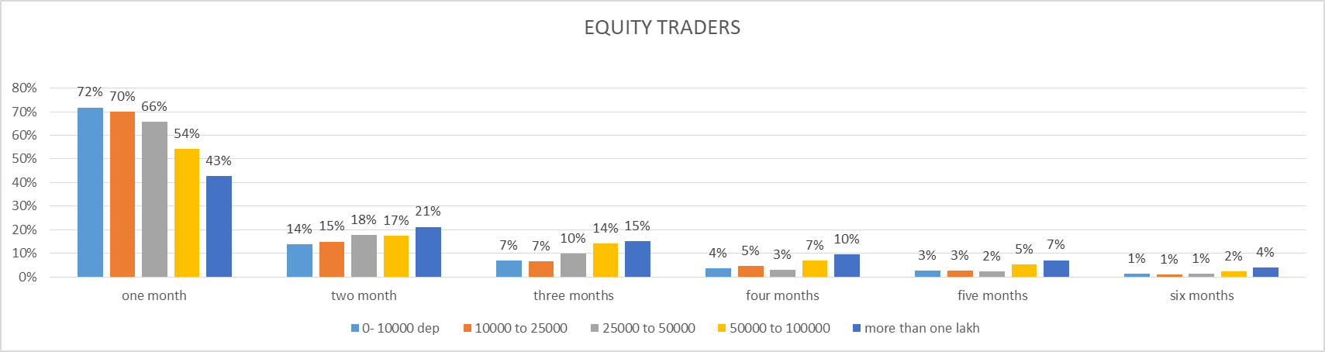
Data Analysis on Client’s lifecycle in Swastika based on first deposit

Slide 5
Problem Statement 1. Client depositing funds between 0 – 10k are 41% and not depositing any funds is also almost 43% 2. most of client (almost 72% ) trading only in equity remain active for almost 1 month 3. most of client (almost 65% ) trading only in equity remain active for almost 1 month

Slide 6
Data Analysis on Client’s lifecycle in Swastika based on first deposit

Slide 7

The Solution
For setup Moment: Offers on Fund deposit.
Mini PMS (Portfolio management service): Customised your portfolio Invest in our recommended baskets (based on our fund allocation algorithim)

Slide 8
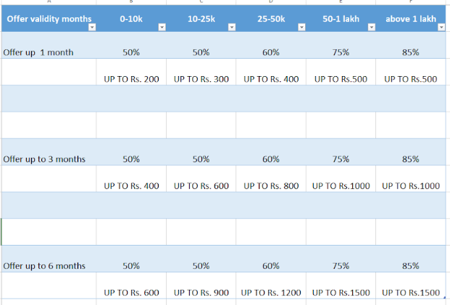
Offers on fund deposit

Slide 9
Mini PMS

Slide 10
Technology stack
SSO with 3rd party’s to enable single click investment
Data of orders placed/positions/holidngs along with reco of the systems
Customisation in holdings & positions API’s
Using tools like signal R to notify client and making them aware push notification API’s

Slide 11
Thank You

